Slide 1




SOFTWARE ENGINEERING (303105253)
Alok Singh Kushwaha

Slide 2
Structured System Design:
Design Concepts,
Design Model,
Software Architecture,
Data Design,
Architectural Styles and Patterns,
Architectural Design,
Alternative architectural designs,
Modelling Component level design and its modeling,
Procedural Design,
Object Oriented Design.
Data Oriented Analysis & Design :
Difference between Data and Information,
E-R Diagram,
Dataflow Model,
Control Flow Model,
Control and Process Specification,
Data Dictionary

Slide 3
1.Structured System Design

Slide 4
Structured System Design is a methodology in software engineering aimed at designing a system in a structured and organized manner.
It focuses on dividing the system into smaller, manageable parts to ensure clarity, modularity, and efficiency during development.
.

Slide 5
2.Design Concepts

Slide 6
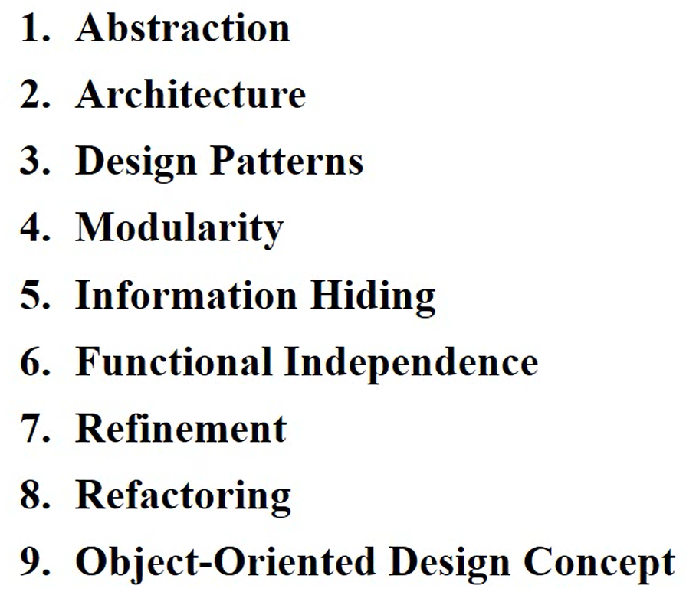
"Design Concepts" in software engineering refer to the fundamental principles and practices used to guide the architecture, design, and development of software systems

Slide 7
Abstraction
Simplifying complex systems by modeling only the necessary details while ignoring the irrelevant parts.
Types of abstraction include:
Data abstraction (e.g., abstract data types)
Control abstraction (e.g., encapsulating algorithms in functions)
Modularity
Dividing a system into smaller, manageable, and independent components (modules) that can be developed and tested separately.
Promotes maintainability, scalability, and reusability.

Slide 8
Encapsulation(Information Hiding)
Restricting access to the internal details of a module and exposing only the necessary functionality.
Helps protect the integrity of the system and reduces interdependencies.
Separation of Concerns
Dividing a software application into distinct features that overlap as little as possible (e.g., separating UI from business logic).
Leads to cleaner and more maintainable code.

Slide 9
Refinement
Gradually adding detail to a system design, starting from a high-level abstract view.
Involves moving from general to specific in the design process.
Design Patterns
Proven solutions to common software design problems.
Examples: Singleton, Factory, Observer, Strategy, and MVC patterns.
SOLID Principles
A set of five principles (SRP, OCP, LSP, ISP, DIP) that guide object-oriented design and architecture.
SRP (Single Responsibility Principle)
OCP (Open-Closed Principle)
LSP (Liskov Substitution Principle)
ISP (Interface Segregation Principle)
DIP (Dependency Inversion Principle)

Slide 10
3.Design Models

Slide 11
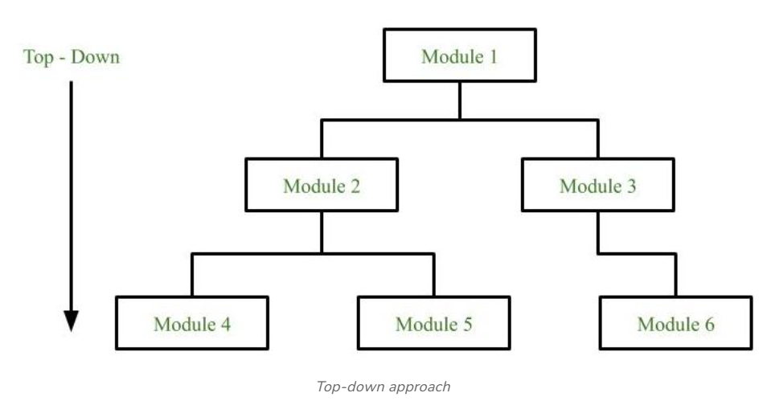
System Design Strategy refers to the approach that is taken to design a software system.
Top-Down Design: This strategy starts with a high-level view of the system and gradually breaks it down into smaller, more manageable components.

Slide 12
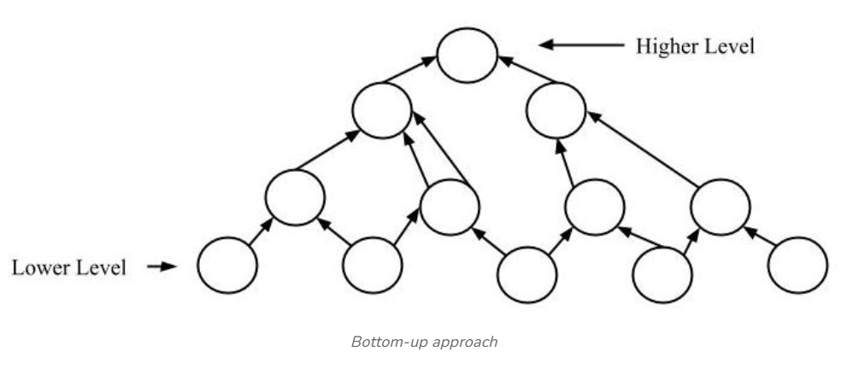
Bottom-Up Design: This strategy starts with individual components and builds the system up, piece by piece.

Slide 13
Advantages of Bottom-up approach:
The economics can result when general solutions can be reused.
It can be used to hide the low-level details of implementation and be merged with the top-down technique.
Disadvantages of Bottom-up approach:
It is not so closely related to the structure of the problem.
High-quality bottom-up solutions are very hard to construct.
It leads to the proliferation of ‘potentially useful’ functions rather than the most appropriate ones.

Slide 14
Iterative Design: This strategy involves designing and implementing the system in stages, with each stage building on the results of the previous stage.
Incremental Design: This strategy involves designing and implementing a small part of the system at a time, adding more functionality with each iteration.
Agile Design: This strategy involves a flexible, iterative approach to design, where requirements and design evolve through collaboration between self-organizing and cross-functional teams.

Slide 15
Examples of Alternative Designs:
Event-Driven Architecture (EDA):
Description: The system is designed around the production, detection, and reaction to events.
Use Case: Real-time systems like IoT or stock trading platforms.
Pros: Decouples components, supports scalability.
Cons: Complexity in managing event flow and debugging.
Service-Oriented Architecture (SOA):
Description: Focuses on services that are reusable and can be composed into workflows.
Use Case: Enterprise-level systems with distributed services.
Pros: Reusability, loose coupling, and scalability.
Cons: Higher initial complexity and costs.

Slide 16
Peer-to-Peer (P2P):
Description: All nodes have equal roles in contributing to the system (no centralized server).
Use Case: File-sharing applications like BitTorrent.
Pros: Resilience, scalability, and fault tolerance.
Cons: Security and coordination challenges.
Serverless Architecture:
Description: Applications are built and deployed without managing servers, using cloud services.
Use Case: Event-driven systems, backend for mobile apps.
Pros: Cost-effective, highly scalable.
Cons: Vendor lock-in and limited control.

Slide 17
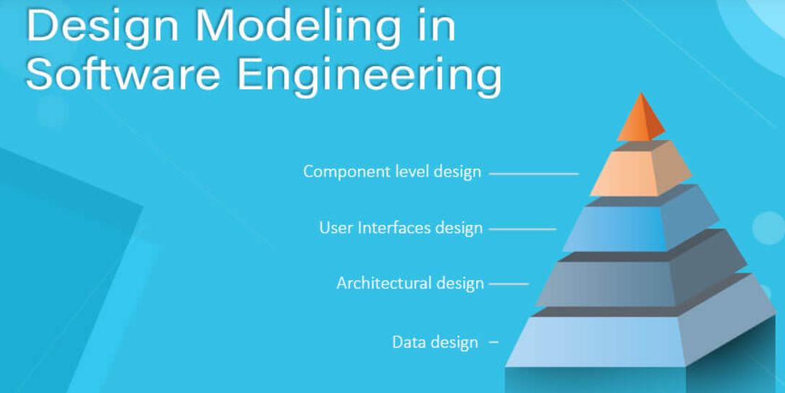

Slide 18
Designing a model is an important phase and is a multi-process that represent the data structure, program structure, interface characteristic, and procedural details.
It is mainly classified into four categories –
Data design,
architectural design,
interface design, and
component-level design.

Slide 19
Design Model:
Data Design: Describes the structure of data used within the system and its flow. Data dictionaries, ER diagrams, etc.
Architectural Design: Depicts the system's high-level structure, components, and their interactions. UML diagrams, layered architecture, etc.
Interface Design: Focuses on user interfaces and the interaction between modules. GUI layouts, API specifications.
Component-Level Design: Details the internal workings of individual modules. Pseudocode, class diagrams, etc.

Slide 20
4.Software Architecture

Slide 21
Definition: Software architecture refers to the high-level structure of a software system and the discipline of creating such structures.
It involves the set of decisions about the organization of a system, its components, their relationships, and how they interact to meet the software’s functional and non-functional requirements.

Slide 22
Importance:
Provides a blueprint for software development.
Ensures scalability and robustness.
Helps in managing complexity.
Facilitates communication among stakeholders.

Slide 23
A software architecture defines
structure of a system.
behavior of a system.
component relationship.
communication structure.
stakeholder’s needs.
influences team structure.
significant elements.
captures early design decisions.
Structural Architecture Characteristics :
Configurability
Extensibility
Supportability
Portability
Maintainability
Operational Architecture Characteristics :
Availability
Performance
Reliability
Low fault tolerance
Scalability

Slide 24
5.Data Design

Slide 25
Definition: Data design refers to the process of structuring and organizing data to support efficient processing, storage, and retrieval while meeting the application’s requirements.
Key Components:
Data Modeling: Creation of data models like Entity-Relationship (ER) diagrams to represent data entities and their relationships.
Database Design: Designing relational or NoSQL databases for optimized storage and retrieval.
Data Structures: Selection of efficient structures like arrays, linked lists, and trees to process data in memory.

Slide 26
Importance:
Ensures data integrity and security.
Optimizes performance by reducing redundancy.
Supports the application’s functionality with efficient data access

Slide 27
6.Architectural Styles and Patterns

Slide 28
Architectural Styles and Patterns
Architectural Styles: Architectural styles define a family of systems with shared characteristics and design principles. Examples:
Layered Architecture: Divides the system into layers like presentation, business logic, and data access.
Client-Server Architecture: Separates the system into clients (requesters) and servers (providers).
Microservices Architecture: Decomposes applications into loosely coupled, independently deployable services.

Slide 29
Design Patterns: Design patterns are reusable solutions to common problems in software design.
Examples:
Model-View-Controller (MVC): Separates user interface, business logic, and data.
Observer Pattern: Allows objects to subscribe and receive updates when the state of another object changes.
Singleton Pattern: Ensures a class has only one instance.
Importance of Styles and Patterns:
Promotes reusability and consistency.
Facilitates easier maintenance and scalability.
Simplifies complex system designs.

Slide 30
7.Alternative architectural designs

Slide 31
Examples of Alternative Designs:
Event-Driven Architecture (EDA):
Description: The system is designed around the production, detection, and reaction to events.
Use Case: Real-time systems like IoT or stock trading platforms.
Pros: Decouples components, supports scalability.
Cons: Complexity in managing event flow and debugging.
Service-Oriented Architecture (SOA):
Description: Focuses on services that are reusable and can be composed into workflows.
Use Case: Enterprise-level systems with distributed services.
Pros: Reusability, loose coupling, and scalability.
Cons: Higher initial complexity and costs.
Peer-to-Peer (P2P):
Description: All nodes have equal roles in contributing to the system (no centralized server).
Use Case: File-sharing applications like BitTorrent.
Pros: Resilience, scalability, and fault tolerance.
Cons: Security and coordination challenges.

Slide 32
Serverless Architecture:
Description: Applications are built and deployed without managing servers, using cloud services.
Use Case: Event-driven systems, backend for mobile apps.
Pros: Cost-effective, highly scalable.
Cons: Vendor lock-in and limited control.

Slide 33
9.Modeling Component-Level Design

Slide 34
Component-level design focuses on defining how individual software components are designed and interact within the architecture.
Modeling Techniques:
Unified Modeling Language (UML):
Class Diagrams: Represent components (classes), attributes, operations, and relationships.
Component Diagrams: Show the physical layout of components in a system.

Slide 35
Data Flow Diagrams (DFDs):
Models the flow of data between components.
Useful for understanding dependencies and interaction.
Sequence Diagrams:
Represents the flow of messages and events between components in a time-ordered manner.
State Diagrams:
Depict the state transitions of individual components based on events.

Slide 36
10.Procedural Design

Slide 37
Procedural design is a method of breaking down a system into well-defined procedures or functions.
It emphasizes a step-by-step sequence of operations to solve a problem or perform a task.
Steps in Procedural Design:
Define High-Level Procedures:
Identify the main functions required for the system.
Example: For a banking app, high-level procedures may include login, account management, and transactions.

Slide 38
Decompose into Sub-Procedures:
Break each high-level procedure into smaller, manageable tasks.
Example: The "Transaction" procedure can be broken into "validate account," "process transaction," and "log activity.“
Design Control Flow:
Use flowcharts or pseudocode to represent the sequence and flow of operations.

Slide 39
Modularize the Design:
Group related procedures into modules for reusability.
Example: A "User Management" module may include login, logout, and password reset functions.
Advantages of Procedural Design:
Simple and easy to understand.
Facilitates reuse of code.
Clear flow of logic and operations.

Slide 40
Modeling Techniques:
Flowcharts:
Visualize the steps and decision points in a procedure.
Pseudocode:
Descriptive representation of the algorithm or logic in plain language.
Hierarchy Charts:
Depict the relationships between procedures and sub-procedures.

Slide 41
11.Object Oriented Design.

Slide 42
Object-Oriented Design (OOD)
Definition: Object-Oriented Design is a software design methodology that uses objects as the fundamental building blocks of the system.
It focuses on defining the system in terms of classes, objects, their attributes, behaviors (methods), and the relationships among them.

Slide 43
Key Concepts in OOD:
Objects:
Real-world entities or conceptual entities represented in software.
Example: A "Car" object with attributes like color, brand, and methods like drive() and stop().
Classes:
Blueprints for objects that define their properties and behaviors.
Example: A "Person" class might define attributes like name and age and methods like walk() and speak().
Encapsulation: Bundling data (attributes) and behaviors (methods) into
a single unit and restricting direct access to the data.
Example: Private variables with public getter and setter methods.
Inheritance:
Mechanism to create new classes based on existing ones, promoting code reuse.
Example: A "Dog" class can inherit attributes and methods from an "Animal" class.

Slide 44
Polymorphism:
The ability for different objects to be accessed through the same interface.
Example: A method fly() may behave differently for "Bird" and "Airplane."
Abstraction:
Focusing on essential features and hiding the implementation details.
Example: A "Shape" class with a draw() method that is implemented differently in subclasses like "Circle" and "Rectangle."

Slide 45
Process of OOD:
Identify Objects and Classes:
Extract objects from the problem domain.
Example: For an e-commerce application, objects could be Customer, Product, and Order.
Define Relationships:
Specify associations, dependencies, and aggregations among objects.
Example: A Customer "places" an Order.

Slide 46
Design Class Diagrams:
Use UML to create class diagrams showing classes, attributes, methods, and relationships.
Define Methods:
Identify and define the methods that encapsulate the behavior of objects.
Advantages:
Promotes modularity and code reuse.
Easier to model real-world scenarios.
Enhances maintainability and scalability.
Disadvantages:
Initial design can be complex and time-consuming.
Overhead in terms of system performance (e.g., in highly abstract designs).

Slide 47
12.Data-Oriented Analysis and Design (DOAD)

Slide 48
Definition: Data-Oriented Analysis and Design is a methodology that prioritizes the organization, structure, and flow of data rather than focusing on processes or objects.
It emphasizes designing systems around efficient handling of data.

Slide 49
Key Principles of DOAD:
Data-Centric Focus:
Identify and structure the data before designing the processes that act upon it.
Example: In a financial application, the key data could be transactions, accounts, and balances.
Data Flow:
Analyze how data flows through the system and ensure minimal redundancy.
Example: Use Data Flow Diagrams (DFDs) to depict how data moves between processes.
Normalization:
Organize data to eliminate redundancy and dependency in databases.
Example: Breaking a table with repeated customer information into separate tables for customers and orders.
Data Integrity:
Design systems that ensure the accuracy and consistency of data throughout its lifecycle.
Example: Using constraints and triggers in relational databases.

Slide 50
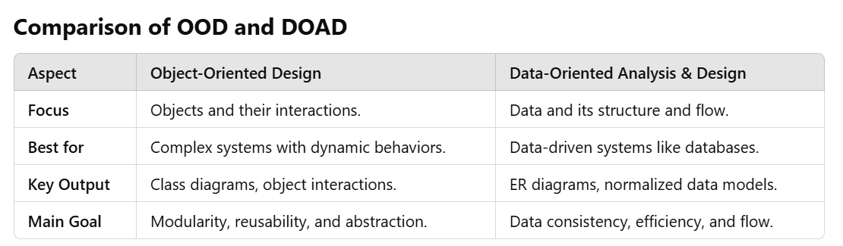

Slide 51
13.Difference between Data and Information

Slide 52
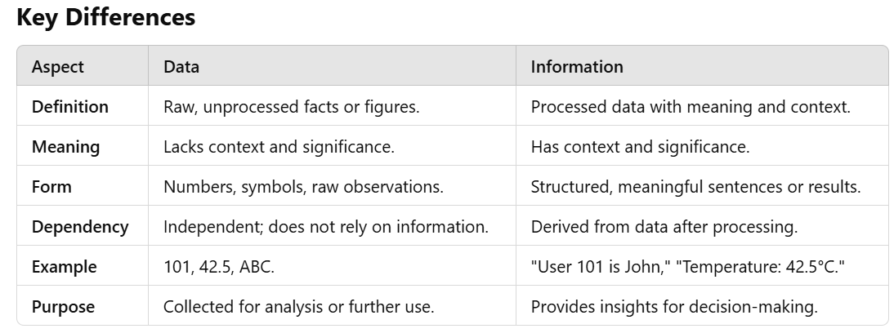

Slide 53
14.E-R Diagram
An Entity-Relationship Diagram (ERD) is a conceptual representation of data in a system, focusing on the entities, their attributes, and the relationships among them.

Slide 54
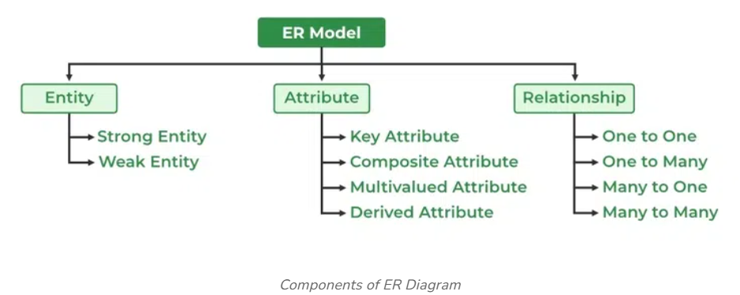

Slide 55
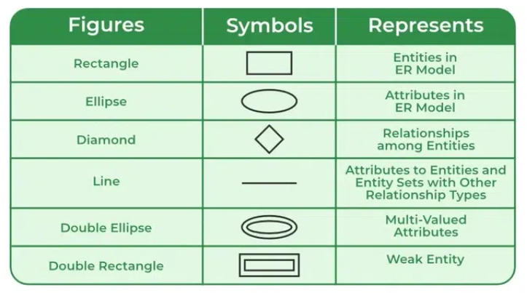

Slide 56
Entities: Objects or concepts within the system.
Strong Entities: Independent objects (e.g., Customer).
Weak Entities: Dependent on another entity (e.g., OrderItem).
Attributes: Characteristics of entities or relationships.
Key Attributes: Unique identifier for an entity (e.g.,Customer_ID).
Derived Attributes: Calculated attributes (e.g., Age from Date_of_Birth). 3.Relationships: Associations between entities.Cardinality: Defines the number of relationships (e.g., 1:1, 1:N, M:N). Participation: Total (mandatory) or partial (optional).

Slide 57
15.Dataflow Model
The Dataflow Model is a conceptual representation used in software engineering, systems design, and analysis to illustrate how data moves through a system.
It focuses on the flow of data between various components, processes, and storage elements, offering a high-level overview of a system's operation.

Slide 58
The Dataflow Model represents how data moves through a system or a process.
It's widely used in computational models, software design, and hardware systems to describe systems where the output is determined by the flow of data between operations.
Data-flow diagrams (DFDs) model a perspective of the system that is most readily understood by users – the flow of information through the system and the activities that process this information.

Slide 59
Example :Online ordering system:
Processes: Validate Order, Calculate Total, Send Confirmation Email.
Data Flows: Customer input → Validate Order → Database → Calculate Total.
Data Stores: User Information Database, Orders Database.
External Entities: Customer, Payment Gateway.

Slide 60
16.Control Flow Model

Slide 61
Characteristics of Control Flow Graph
The control flow graph is process-oriented.
The control flow graph shows all the paths that can be traversed during a program execution.
A control flow graph is a directed graph.
Edges in CFG portray control flow paths and the nodes in CFG portray basic blocks.

Slide 62
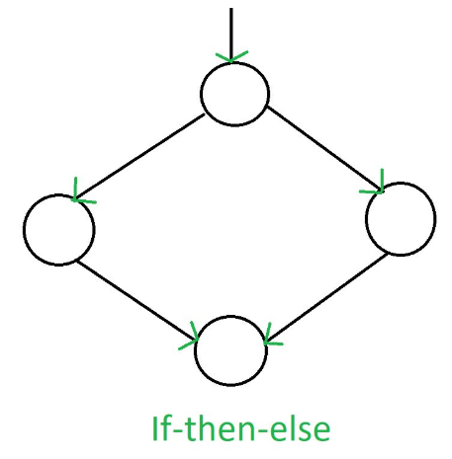
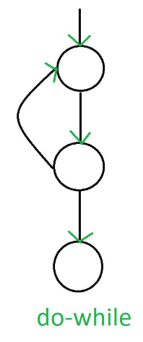
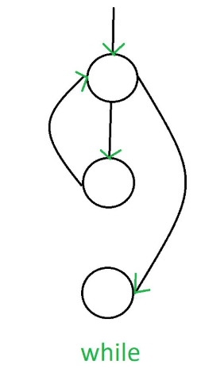
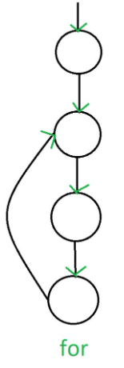

Slide 63
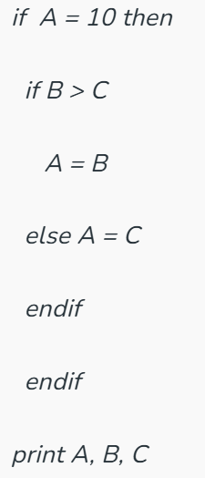
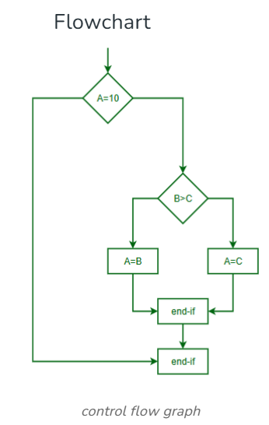
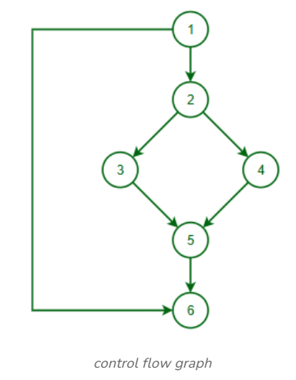

Slide 64
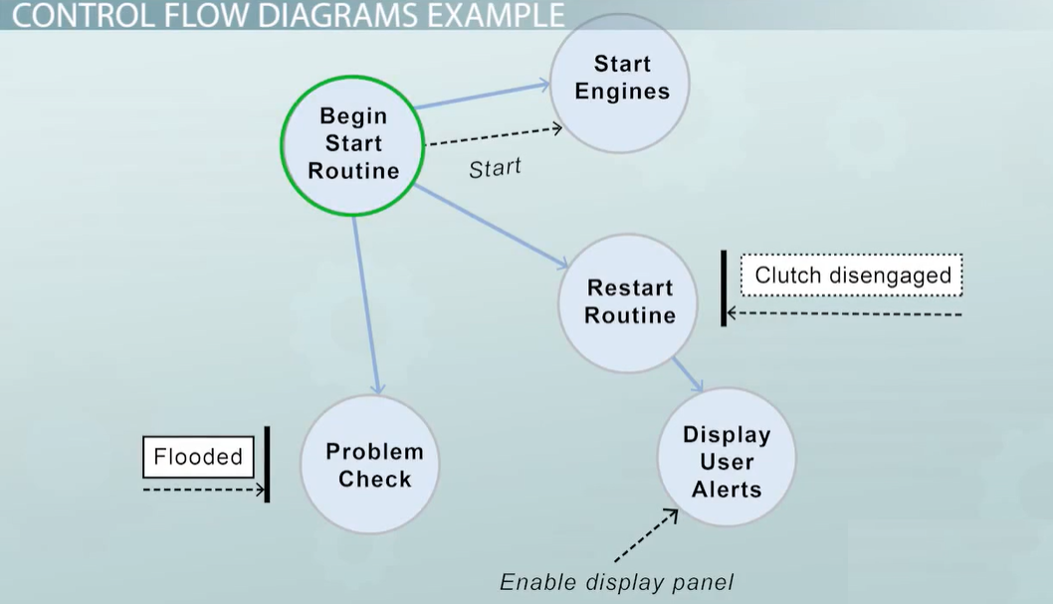

Slide 65
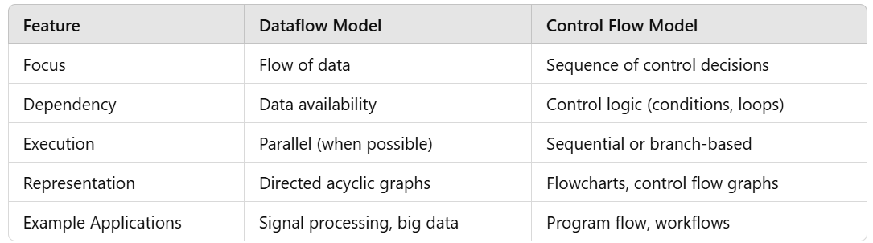

Slide 66
17.Control and Process Specification

Slide 67
Control Specification (CSPEC) and Process Specification (PSPEC) are essential components that provide detailed descriptions of system behavior.
They are used to ensure clarity and precision in defining how a system operates, especially in response to different inputs or control events.

Slide 68
1. Control Specification (CSPEC)
Definition:
Control Specification (CSPEC) defines the control logic of a system, including the events, conditions, and actions that govern its behavior. It outlines how the system responds to external or internal events in terms of control signals and system state changes.
Purpose:
To describe the behavior of the system in response to control events.
To capture dynamic aspects of the system, such as state transitions.
To specify the interactions between processes triggered by events.
2. Process Specification (PSPEC)
Definition:
Process Specification (PSPEC) provides a detailed description of what a specific process does, including its inputs, outputs, and transformations. It focuses on the functional behavior of individual processes within a system.
Purpose:
To define the operations of individual processes in detail.
To ensure clarity for developers during implementation.
To complement Data Flow Diagrams (DFDs) by detailing how data is processed.

Slide 69
18.Data Dictionary

Slide 70
Data Dictionary
A Data Dictionary can be defined as a collection of information on all data elements or contents of databases such as data types, and text descriptions of the system.
It makes it easier for users and analysts to use data as well as understand and have common knowledge about inputs, outputs, components of a database, and intermediate calculations.

Slide 71

www.paruluniversity.ac.in

